Slide 1



PROPELLER PROGRAM
2023 GROUP
PROJECT

Slide 2
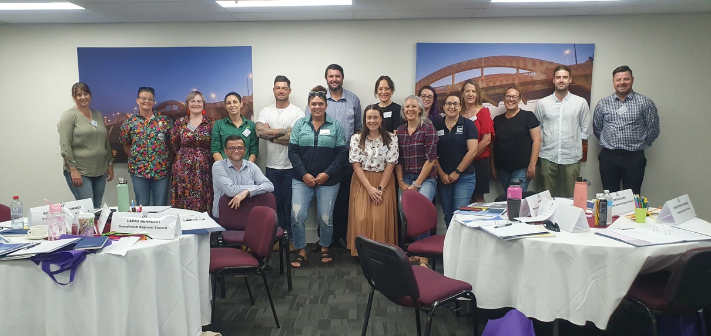
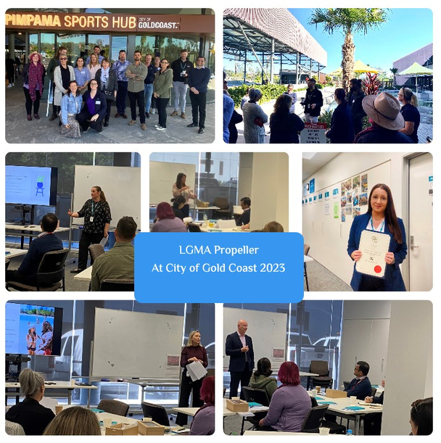
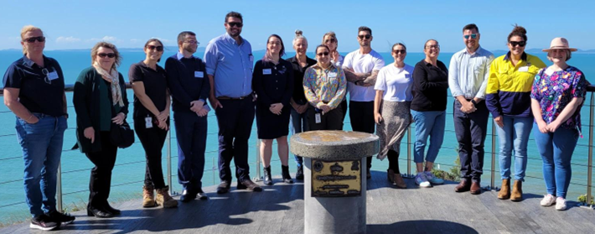
Introduction
LGMA
Propeller
2023 Propeller
2023 PROPELLER PROGRAM
Notes:
The LGMA began as the Institution of Municipal Administration in 1951 and has become a leading professional body for managers in Queensland’s local government sector.
Offering a wide range of courses aimed at all levels of leadership from officers to chief executive officers the LGMA are focused on the professional development of Queensland’s local leaders.
The propeller programme is one such course offering its participants a broader understanding of Queensland’s local government through knowledge sharing from experienced specialists in host councils.
The 2023 Propeller program hosts ** local government employees from across QLD representing ** different Councils.

Slide 3

Introduction
Our communities have been feeling the effects of an ever-changing climate and look to their local leaders for action in climate change initiatives.
2023 PROPELLER PROGRAM
Notes:
The Local Government Managers Australia (LGMA) have recognised this and have tasked the members of its Propeller Programme with determining what Local Government’s (LG’s) role is in leading, managing, enabling and educating climate change initiatives.
This presentation will act as a guide, defining the role of local government in climate change initiatives, give examples of some initiatives currently employed in the community and connect the user with tools and resources to begin their own climate change journey.

Slide 4
Responsibilities and legislation
Climate Change Bill 2022 [and] Climate Change (Consequential Amendments) Bill 2022 / Climate Change Act 2022 (Cth) (Climate Act)
  The Bill aims to legislate Australia’s greenhouse gas emission reduction targets (of 43% reduction against a 2005 baseline by 2030 and net zero emissions by 2050).
Climate Change and Greenhouse Gas Reduction Act 2010 (QLD)
  A 75% reduction in emissions on 2005 levels by 2030; Net zero emissions by 2035.
  Establishing a fossil fuel exports reduction target to phase out exports of coal, oil and gas by 31 December 2030
EPOLA Act 2023
Queensland Climate Transition Bill 2023
The Queensland Environmental Offsets Policy
2023 PROPELLER PROGRAM
Notes:
Climate change is an existential imperative and humanity has recognised and accepted this reasonability with a historical breakthrough of the Paris Agreement in 2015. This agreement legally binds 194 parties, including Australia, to the reduction of global greenhouse gas emissions and limit the temperature increase to 2 degrees Celsius this century.
The Australian government has taken this agreement seriously and has legislated that Australia will be at net zero emissions by 2050 and by 2030 Queensland will be 30% below emission levels of 2005. This national commitment has speared on the creation of Queensland’s climate action plan that illustrates actions taken in sectors such as Energy, Transport, Industry, Buildings and Land since 2020 and actions that are currently underway. This action plan also outlines a partnership with the Local Government Association of Queensland to assist LG’s in beginning their climate change journey.

Slide 5
Links
United Nations Paris Agreement
Australian Government Path to Net Zero 2050
LGAQ Advocacy Action Plan 2023
Queensland Climate Action Plan
Snapshot Climate - Australian Emissions Profiles
Guide to Climate Change Risk Assessment for NSW Local Government
Climate Change Risk Management Tool for Queensland Households
2023 PROPELLER PROGRAM
Notes:
Responsibilities and legislation links:
The United Nations Paris Agreement is a legally binding international treaty on climate change.
Australian Government Path to Net Zero 2050 is a long-term emissions reduction plan to achieve net zero emissions by 2050.
The Queensland Government has set targets for reducing emissions in the documented Queensland Climate Action Plan.
Snapshot Climate link is designed to help communities, decision makers and government take action on climate.
Guide to Climate Change Risk Assessment for NSW Local Government is a guide designed to assist councils assess the risks of climate change.
Climate Change Risk Management Tool for Queensland Households is a tool or resource that has been developed to help households start their adaptation journey and what they can do regarding climate change.

Slide 6




Where to start?
“Recognizing the importance of the engagements of all levels of government and various actors, in accordance with respective national legislations of Parties, in addressing climate change”
Adoption of the Paris Agreement
Leading
Managing
Enabling
Educating
2023 PROPELLER PROGRAM
Notes:
Knowing where you are is a great first step in knowing where you need to be and there are many resources at your disposal to assess the status of your community but before beginning any task or undertaking it is always prudent to conduct a risk assessment to identify hazards and how best to mitigate their impact.

Slide 7

Leading
What is leading? Leading is that management function with involves influencing others to engage in the behaviours necessary to reach a goal.
Having great importance, influence or success.
LEADING refers to the function while, LEADERSHIP refers to the process.
Be the Change: The Lazy persons guide to saving the world. The Lazy Person's Guide to Saving the World - United Nations Sustainable Development
"Before you are a leader, success is all about growing yourself. When you become a leader, success is all about growing others." -Jack Welch.
2023 PROPELLER PROGRAM
Notes:
Attached is a link that shows your municipalities emissions across sectors such as residential, commercial, industry and transportation and also includes a user’s guide. This guide helps the user navigate and understand the data shown as well as providing examples of how best to use the data provided.
Information and education at a local government level can help our communities understand how every step towards living a sustainable lifestyle makes a difference in achieving climate change objectives.
Leadership is the ability of an individual to influence, motivate, and enable others to contribute.
How can councils influence, motivate, and enable others:
- Needs to align with council vision and goals
- Have its own house in order first
- Understand its environmental impact
- Set an emissions reduction target to signal ambition and inspire action.
- Set minimum energy efficiency standards for council-owned buildings and assets
- Incorporate climate change risks into council decision-making, local planning schemes and developments
provided a range of training programs, protocols and processes to assist council staff to identify and manage climate change impacts
- Development of regionally appropriate climate preparedness plans
- Carbon Neutral Action Plan
leading the community and others in developing a vision for the area and the steps to achieve it.
- Encourage community participation in climate and environmental programs.
citizen science projects.
- Educate people on the solutions
- Share our content
- Have conversations
- Shape the national conversation

Slide 8





Leadership Examples
These are just some of the examples, you can find more information on the Queensland Climate Action website. Queensland Climate Action (des.qld.gov.au)
Council | Target examples
Noosa Shire Council | First local government in QLD to declare a climate emergency and has developed a Climate Change Response Plan that outlines its actions and targets to reduce emissions and adapt to climate impacts.
Brisbane City | Set a goal to become a carbon neutral organisation by 2027 and has implemented various initiatives to improve energy efficiency, increase renewable energy, reduce waste and enhance green spaces.
Cairns Regional Council | Adopted a Climate Change Strategy 2017-2030 that aims to achieve net zero emissions by 2030 for its own operations and 2050 for the whole community, as well as increasing resilience to climate hazards.
Gold Coast City Council | Established a Climate Change Response Unit that coordinates and monitors its climate actions, such as reducing emissions from transport, buildings and waste, and protecting natural assets and biodiversity.
Sunshine Coast Council | Launched a Clean Energy Transition Plan that outlines how it will transition to 100% renewable electricity by 2022 for it's own operations and by 2038 for the entire region, as well as supporting community engagement and education on climate change.
2023 PROPELLER PROGRAM

Slide 9



Advanced Leadership Examples
Governing body | Target examples
The IPCC (Intergovernmental Panel on Climate Change), | (Intergovernmental Panel on Climate Change), which is the leading international body for the assessment of climate change and provides scientific reports and guidance for policymakers.
The Paris Agreement | Global treaty that aims to limit global warming to well below 2°C and requires countries to submit their plans to reduce greenhouse gas emissions.
The EU | Set ambitious targets to become the first climate-neutral continent by 2050 and has adopted a comprehensive set of policies and measures to achieve this goal, such as the EU Green Deal and the EU Emissions Trading System.
The United States | Rejoined the Paris Agreement under the Biden administration and has pledged to cut its greenhouse gas emissions by 50-52% below 2005 levels by 2030, as well as investing in clean energy and infrastructure.
The United Kingdom | Hosted the COP26 Summit in Glasgow in 2021 and has committed to reduce its greenhouse gas emissions by 68% by 2030 and by 78% by 2035, compared to 1990 levels, as well as phasing out coal power by 2024.
2023 PROPELLER PROGRAM

Slide 10
Managing
What is managing? Managing in local government refers to the process of overseeing and directing the operations and activities of a local government organization.
This involves planning, organizing, coordinating, controlling, and evaluating the resources, functions, and services provided by the government to meet the needs of the community.
“Good management is the art of making problems so interesting and their solutions so constructive that everyone wants to get to work and deal with them.” — Paul Hawken.
2023 PROPELLER PROGRAM

Slide 11

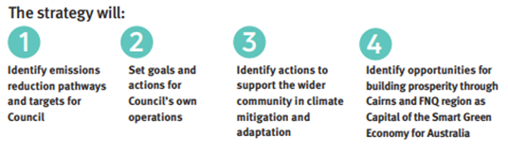
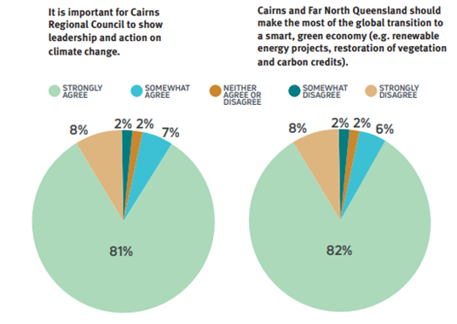
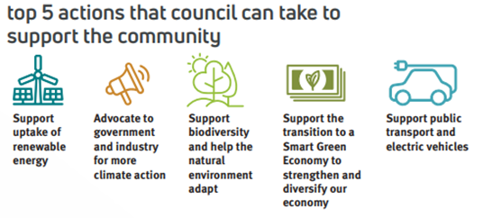
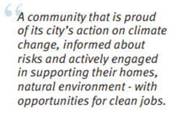
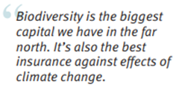
Managing Examples
Council | Target examples
Cairns Regional Council | Climate Change strategy 2030
2023 PROPELLER PROGRAM
Notes:
Cairns Regional Council
Through consultation and engagement, over 88% of survey respondents in the Cairns community said they wanted Council to show leadership and action on climate change. Through the consultation and engagement process, Council spoke and listened to subject matter experts, industry representatives, climate action advocates, community members, First Nations People, youth representatives and researchers in the tertiary sector which gathered valuable information and feedback to move forward with the implementation of climate change strategies and initiatives. To put a strategy plan in place, the community have outlined their objectives, what success looks like and actions to achieve success. The success is measured through municipal emissions snapshot, number of sustainability grant projects with a climate action focus and the number of workshops or engagement events.

Slide 12
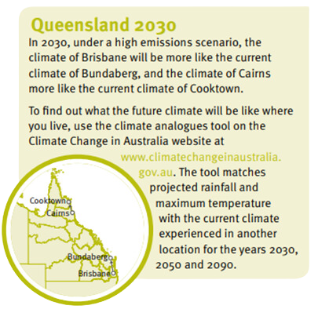
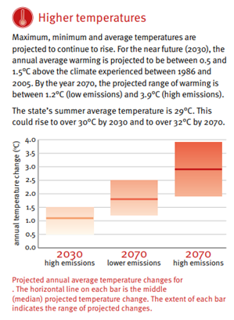
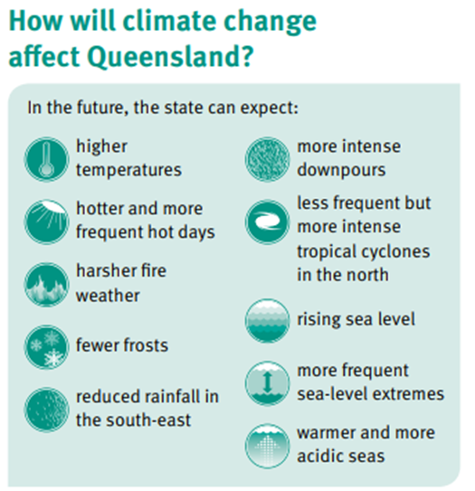
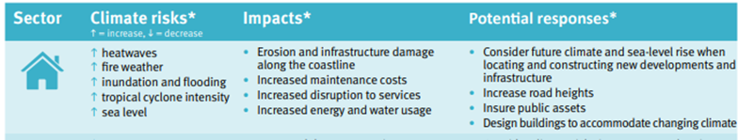
Managing Examples
Council | Target examples
QLD Government Climate Change Science Resources | Extensive work is being undertaken in Queensland to identify the opportunities and risks that are presented though data that has been collated.
2023 PROPELLER PROGRAM
Notes:
QLD Government Climate Change Science Resources.
Extensive work is being undertaken in Queensland to identify the opportunities and risks that are presented though data that has been collated.
Some of the potential responses to the climate risks are:
- Consider future climate and sea-level rise when location and constructing new developments and infrastructure
- Implement water management planning
- Identify cultural sites at risk and mitigate impact
- Employ strategies to minimise heat stress on livestock
- Consider different crop varieties and sowing times
- Improve water efficiency
- Increase green urban infrastructure and urban biodiversity
- Link habitats to allow species to move
- Implement rural mental health care programs
- Consider climate risks when developing emergency planning for schools, hospitals, services

Slide 13
Enabling
What is enabling? Removing barriers and providing resources.
Enabling in local government refers to removing barriers and providing resources, whether that be through in-kind support, financial resources, or policy changes.
"I alone cannot change the world, but I can cast a stone across the waters to create many ripples." — Mother Teresa
2023 PROPELLER PROGRAM

Slide 14



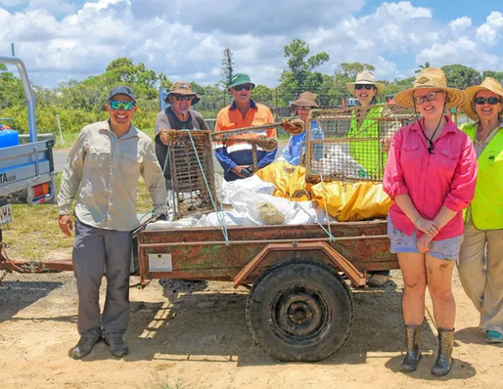

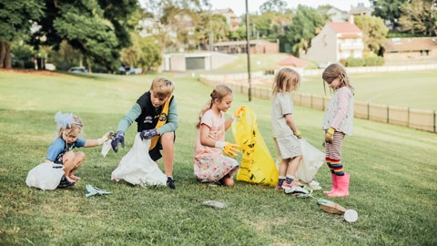
Enabling Examples
Council | Target examples
Western Downs Regional Council | Approval of new solar farm at Kumbarilla.
Livingstone Shire Council | Support various community beach clean-ups such as Clean up Australia Day by removing collected rubbish from these events, as well as promote these events. https://www.livingstone.qld.gov.au/news/article/482/livingstone-shire-council-supports-capricorn-coast-landcare-for-clean-up-australia-day https://www.capcoastlandcare.org/
Moreton Bay Regional Council | Support various community beach clean-ups such as Clean up Australia Day by removing collected rubbish from these events, as well as promote these events. https://www.moretonbay.qld.gov.au/Events/Clean-Up-Australia-Day
2023 PROPELLER PROGRAM
Notes:
Western Downs – Council approving new solar farm at Kumbarilla, adding to an influx of renewables projects on the go in the region. "This is the 23rd solar farm approval granted by Council in the last four years (28/10/2020), adding to an influx of renewable projects with a combined $4 billion to the Western Downs. On top of this, our region is also welcoming new wind farms, such as the recently constructed Coopers Gap Wind Farm, the approved Dulacca Wind Farm and the newly approved Wambo Wind Farm.”
Livingstone Shire and Moreton Bay Regional Council - In partnership with Capricorn Coast Landcare, these councils support various community beach clean-ups such as Clean up Australia Day by removing collected rubbish from these events, as well as promote these events.

Slide 15



Enabling Examples
Council | Target examples
Brisbane City Council | Free Native Plants program
Sunshine Coast, Moreton Bay & others (Native Plants QLD) | Largely sponsored by local governments and providing inexpensive native plants through volunteer nurseries
2023 PROPELLER PROGRAM
Notes:
Brisbane City Council’s free Native Plants program offers a range of plants to enable the community to cultivate a greener and more sustainable Brisbane. The native species provided through the program will help grow our city’s urban forest and support wildlife. Residents, schools, community groups, clubs can get two free native plants.

Slide 16
Educating
What is educating? providing information, knowledge, and skills to individuals and communities to enable them to make informed decisions and participate effectively in local government processes.
In local government refers to the process of providing information, knowledge, and skills to individuals and communities to enable them to make informed decisions and participate effectively in local government processes. The goal of educating is to promote civic engagement, enhance transparency, and build trust between local government officials and the communities they serve.
"A good teacher is like a candle—it consumes itself to light the way for others." –Mustafa Kemal Atatürk.
2023 PROPELLER PROGRAM
Notes:
Educating in Local Government refers to the process of providing information, knowledge, and skills to individuals and communities to enable them to make informed decisions and participate effectively in Local Government processes. The goal in educating is to promote civic engagement, enhance transparency, and build trust between Local Government officials and the communities they serve.
Throughout this presentation we’ve touched on the other aspects Local Government drives in Leading, Managing and Enabling Climate Change Initiatives. Education influences these other aspects outlined in various ways and will vary depending on the purpose and target audience.

Slide 17

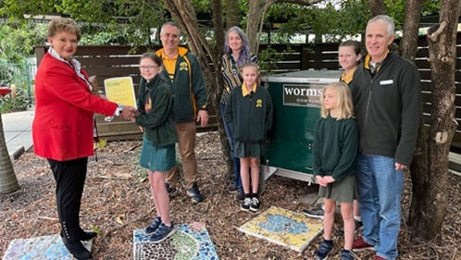
Educating Examples
Task | How that looks
Community Days | Cairns Ecofiesta, it is Queensland's premier sustainability festival (Cairns, Townsville)
Free Tree giveaways | Planet Ark’s National Tree Day planting Initiatives
School Programs | Where Education Officers/Officers teach children all about topics, who in turn teach the parents
Leaflets/ brochures | Sustainability Champions Program run by City of Moreton Bay Council
2023 PROPELLER PROGRAM
Notes:
Education within Local Government will take on many forms and it isn’t limited. It can be Local Council providing:
- Information sessions on topics or strategies implemented by Local Government to provide the community information
- Information sessions for Staff/Contractors would be beneficial to increase skills and knowledge within the workforce, who in turn are the point of contact for most of the community
- Consultation workshops on topics or strategies to be implemented by State or Local Government to disseminate information
- Work with the community for them to effectively be involved in decision making
- Many larger Councils have Education Officers whose portfolios could be increased to include climate change
- Publish resources, strategies or guides
(resources can be in any medium designed for the biggest impact to circulate information)
- Provide the ability for the workforce to attend seminars/workshops
- Upskill workforce to be able to provide internal speaker services for workshops/training
- Broadcast any programs that are available, nationally, interstate and locally
- Manage/run the workshop
There are multiple websites already established to assist Local Governments in their journey through Climate Change. And as already shown through the Leading, Managing and Enabling sections all these resources readily available are all interconnected in some way.

Slide 18

Where to start?
What we have observed throughout this Project is that the best starting point is “what is your community already doing?” Every community has groups of people that are passionate about the environment and climate change – including people that already work for us! Find out who they are, gather them and see what we as council can do to help.
2023 PROPELLER PROGRAM
Notes:
Climate change can be a daunting topic to address. Everyone is at different stages in their communities as they tackle this issue. It is important that we as council don’t compare ourselves to other councils but rather see what we can learn and adapt to our own communities.

Slide 19
Conclusion
Local Governments have extensive roles in leading, managing, enabling and educating climate change initiatives. As our communities express concerns of an ever-changing climate and look to their local leaders for action in climate change initiatives.
“Sustainable development is the development that meets the needs of the present without compromising the ability of future generations to meet their own needs.” - Gro Harlem Brundtland.
“Persistence is what makes the impossible possible, the possible likely and the likely definite” - Robert Half
2023 PROPELLER PROGRAM
Notes:
“Persistence is what makes the impossible possible, the possible likely and the likely definite” - Robert Half
Local Government is closest to the people and therefore their role is to respond to community needs, expectations and concerns – when this includes climate change Local Government responds accordingly depending on their location and community ‘feel’.
Every local government is different (geography, demographics, size etc) so every local government responds differently/appropriately to their constituents.
Local government is bound by law to address climate change in various ways (mostly achieving targets), however will fulfil this obligation differently.

